Slide 1
3D Printing technology
Endless Possibilities
Taimoor (14031)
Sher Ali (13962)
Dawood Khan ()

Slide 2
How we make things ?
Four ways to make things
Subtractive Manufacturing
Forming
Molding
Additive Manufacturing

Slide 3
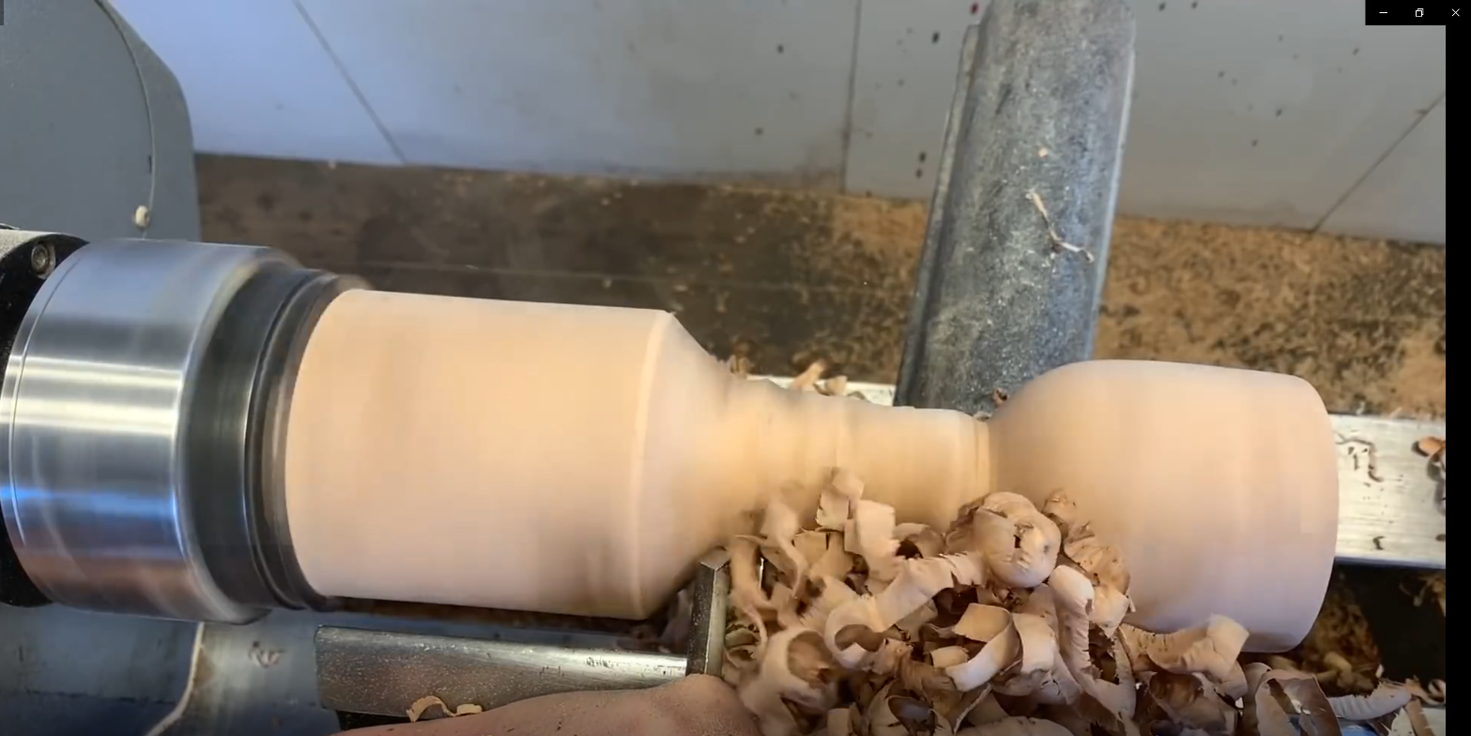
Subtractive manufacturing
Subtractive manufacturing is an umbrella term for various controlled material removal processes that start with solid blocks, bars, rods of plastic, metal, or other materials that are shaped by removing material through cutting, boring, drilling, and grinding.

Slide 4
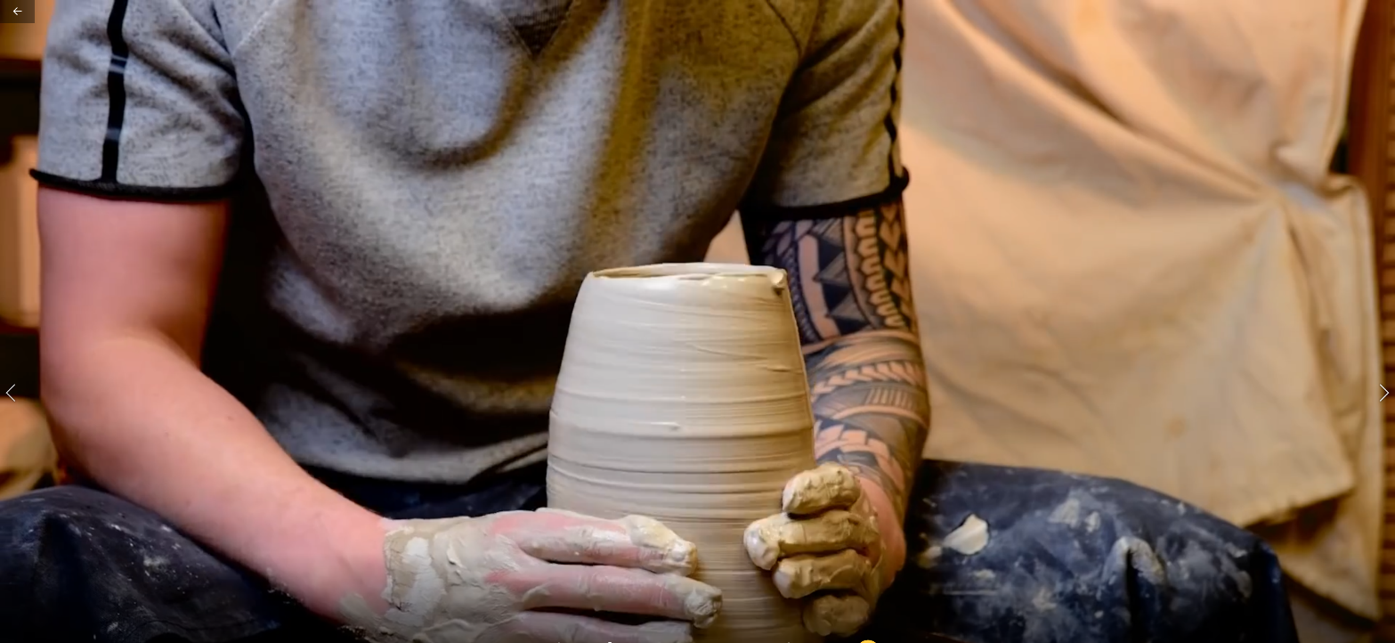
Forming
Forming is a manufacturing process in which the shape of a partly finished product, for example sheet metal, is changed using deformation.
During forming, force is applied to a piece of sheet metal to change its shape rather than remove any material.

Slide 5
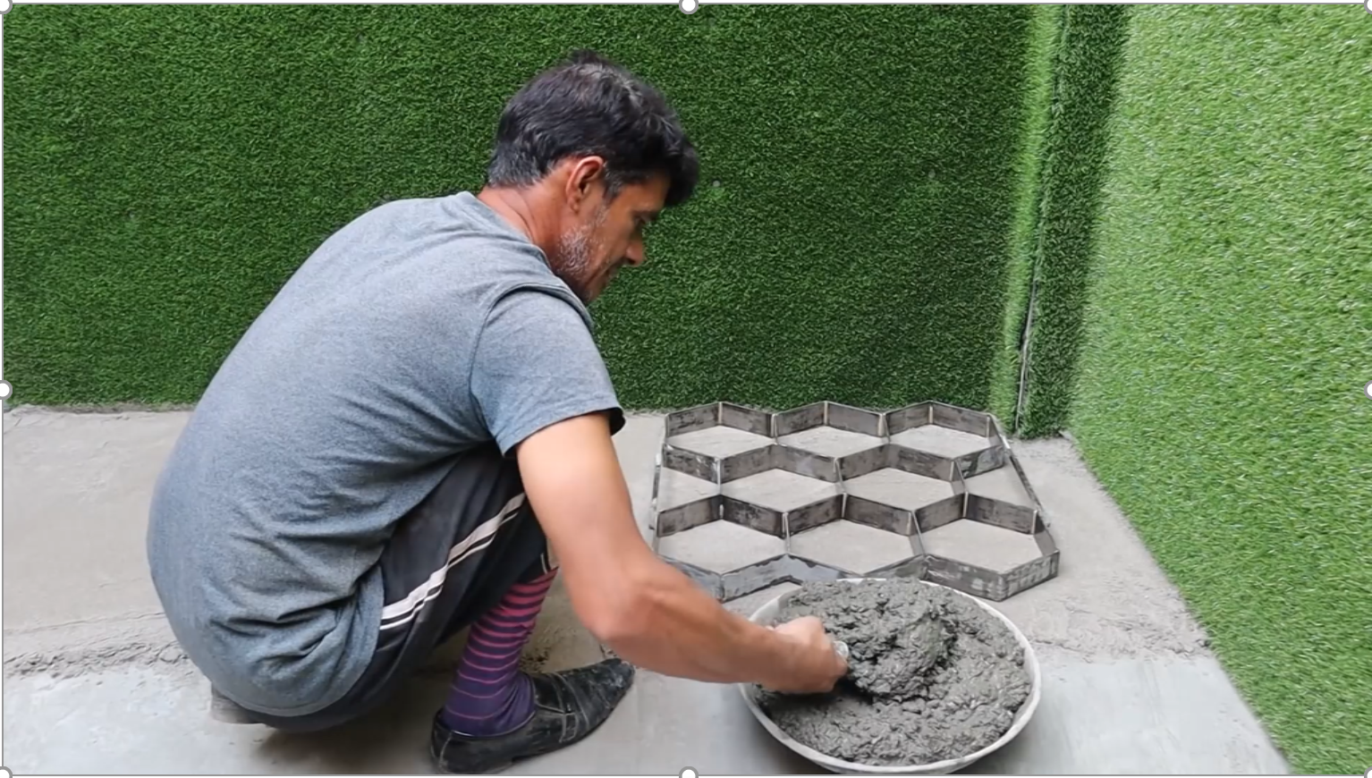
molding
Molding is the process of manufacturing by shaping liquid or pliable raw material using a rigid frame called a mold or matrix.
This itself may have been made using a pattern or model of the final object.

Slide 6
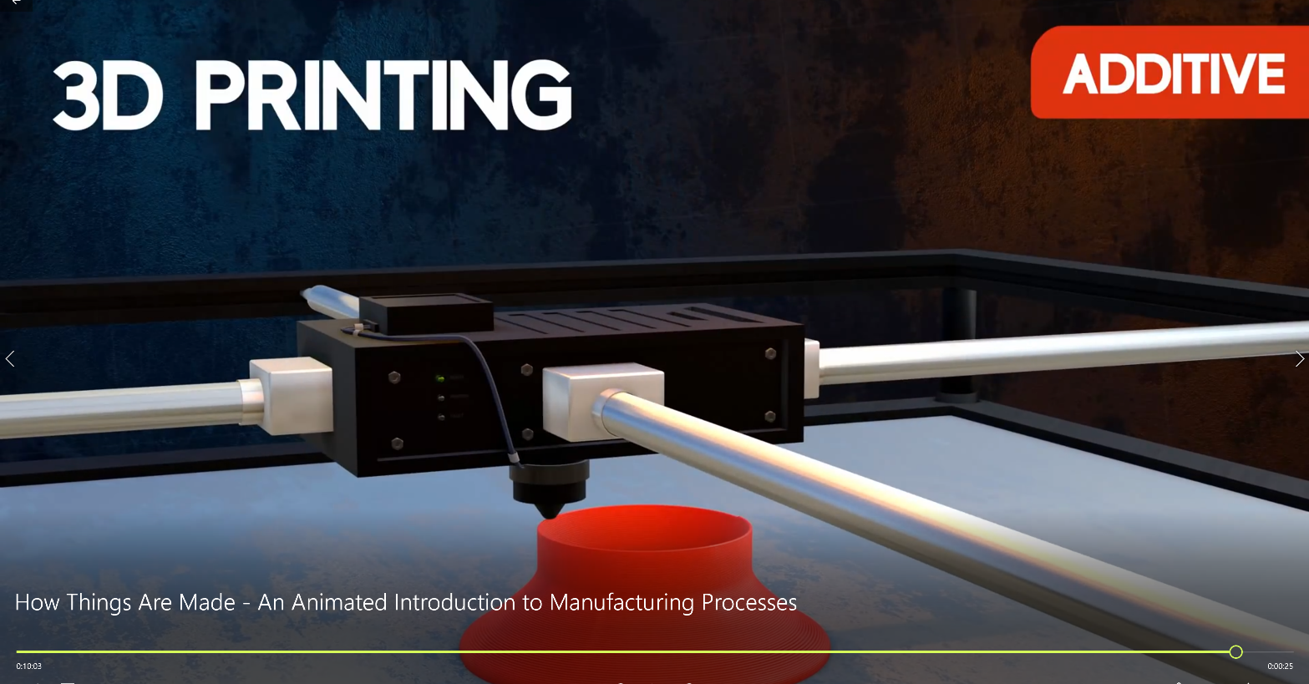
Additive manufacturing
Additive manufacturing is the process of creating an object by building it one layer at a time.
It is the opposite of subtractive manufacturing, in which an object is created by cutting away at a solid block of material until the final product is complete.

Slide 7
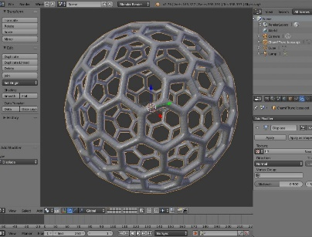
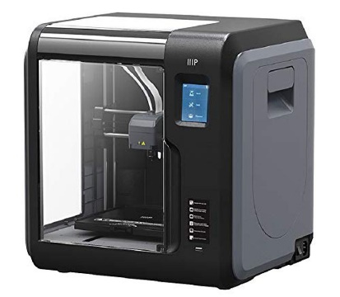
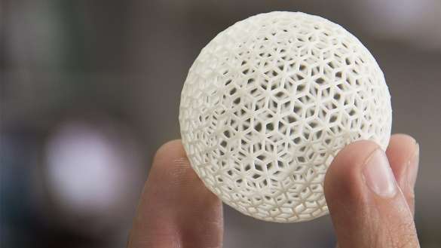
What is 3d printing?
3D printing or additive manufacturing is the construction of a three-dimensional object from a digital 3D model.
It can be done in a variety of processes in which material is deposited, joined or solidified under computer control, with material being added together, typically layer by layer.
3D digital file
3D Printer (FMD)
3D printed object

Slide 8
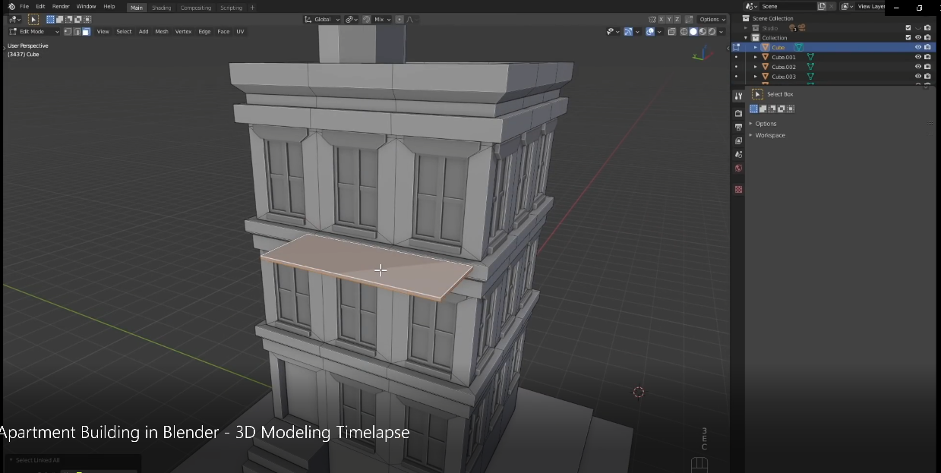
how to prepare 3d files?
Modeling your 3d file in any 3D modeling software like blender, auto-cade, auto-disk etc.
Tons of free 3D models are available on different web sources for download.
For highly customized 3d model you can hire a 3d artist on freelancing websites who can model your design.
For exact copy of an object you can 3d scan it.
Slicing the model in slicing software for 3d print.

Slide 9
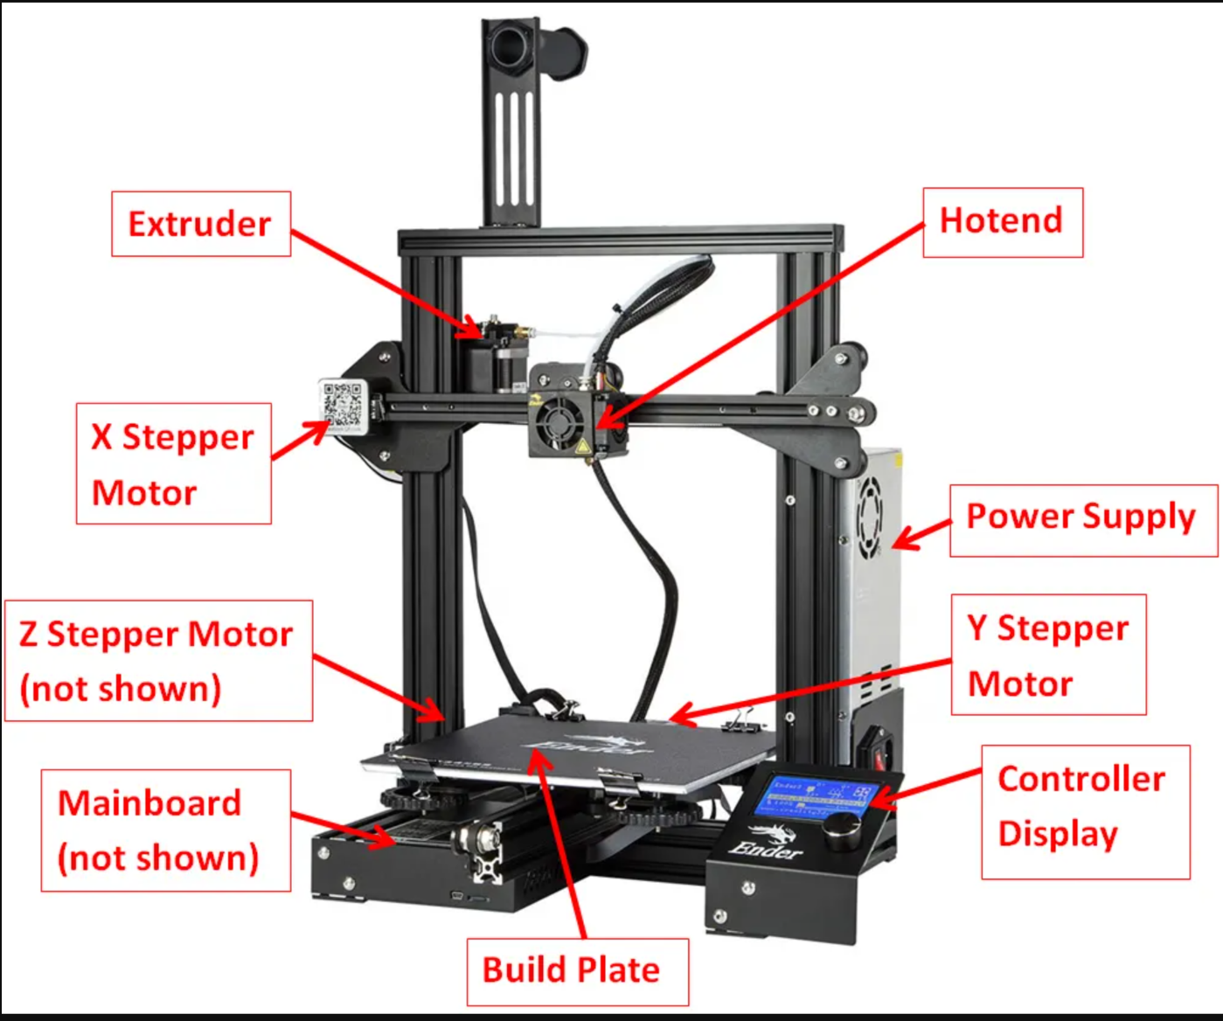
HOW IT (fdm) WORKS?
Components
Controller Board
Filament
Frame
Stepper Motors
Belts
Threaded rods
Power Supply
Print bed
Print head

Slide 10
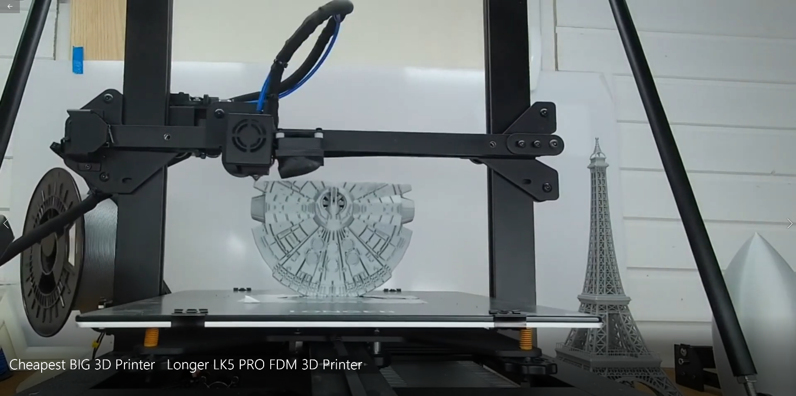
Mechanism
A 3D printer essentially works by extruding molten plastic through a tiny nozzle that it moves around precisely under computer control. It prints one layer, waits for it to dry, and then prints the next layer on top.

Slide 11
What are its pros and cons?
Pros
Cons
Flexible design
Rapid Prototyping
Print on demand
Strong and light weight parts
Fast design and production
Minimizing waste
Cost effective
Ease of access
Environment friendly
Limited material
Restricted build size
Post processing
Large volume
Part structure
Reduction in manufacturing jobs
Design inaccuracy
Copy right issues

Slide 12
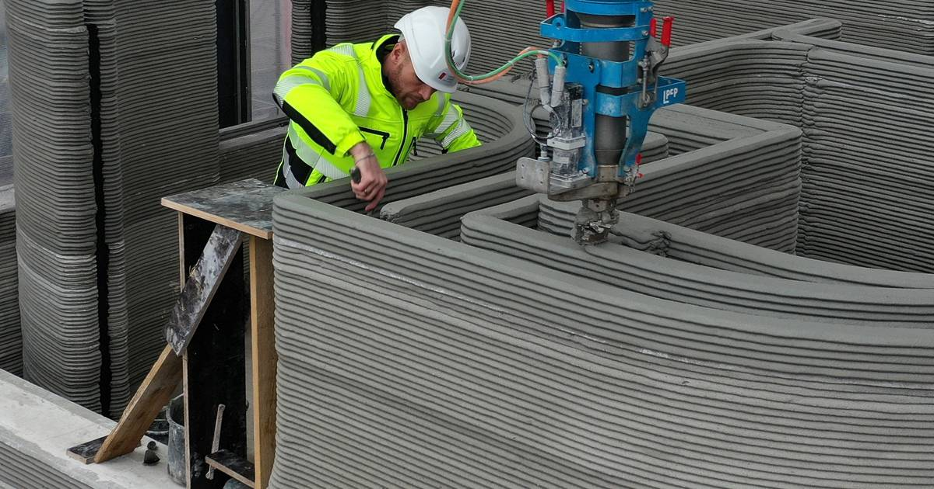
Where we use 3d printing?
Construction
Prototyping and Manufacturing

Slide 13
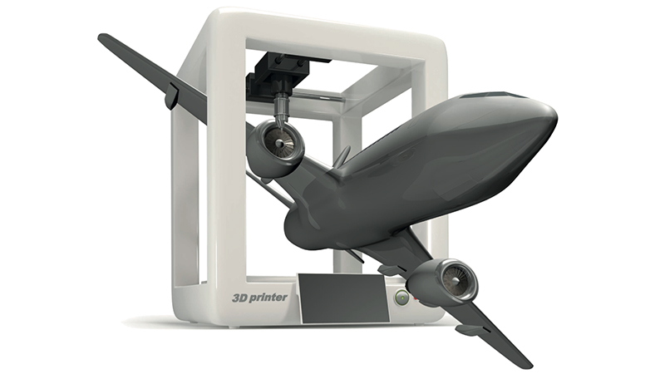
Automotive
Aerospace

Slide 14
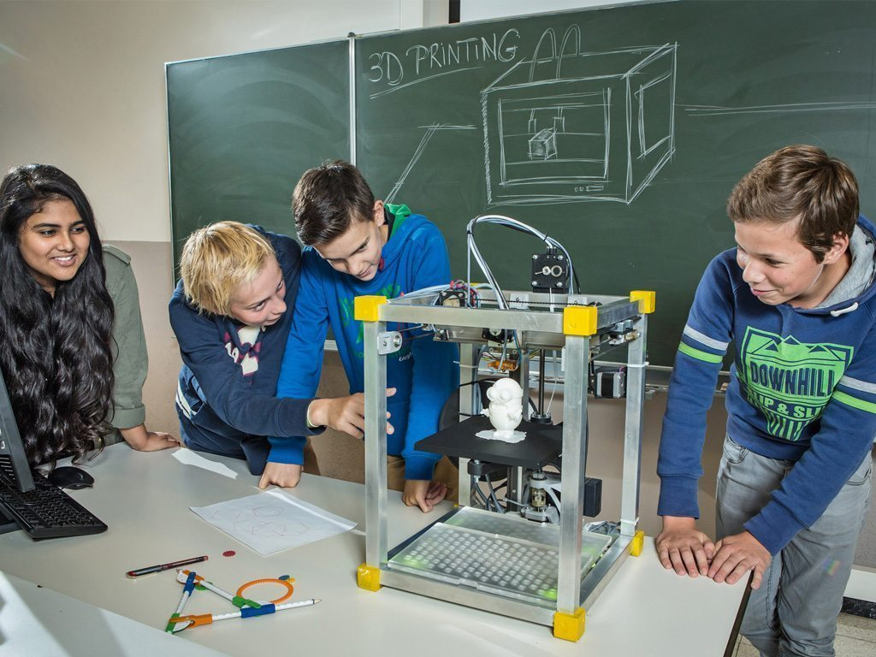
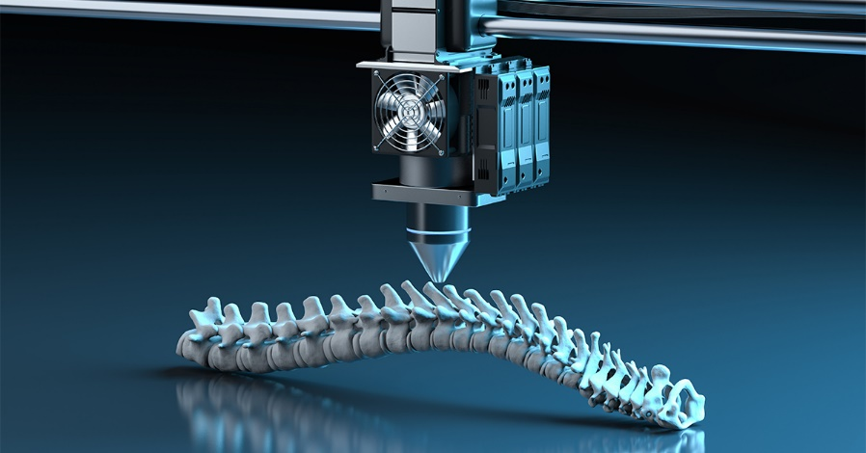
Education
Health care

Slide 15
3D PRINTING VERSUS TRADITIONAL MANUFACTURING METHODS
3D PRINTING METHODS
TRADITIONAL METHODS
Selective Laser Sintering (SLS),
Binder Jetting,
Stereo lithography (SLA)
Poly-Jet
Fused Deposition Modelling/Fused Filament Fabrication (FDM/FFF), etc.
Injection molding
Machining
Forming
Joining.

Slide 16
which ONE IS BEST?
The best method for manufacturing of any product or its part in terms of cost and quality depends mainly on the following factors.
Quantity: How large is the production run?
Lead time: How soon do you need your part?
Complexity of shape: What is your item shape?
Material selection: What material do you need ?

Slide 17
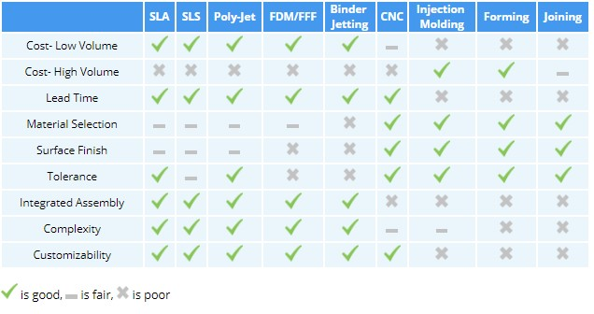
The above chart shows comparison between different between additive and other manufacturing methods based on different factors

Slide 18
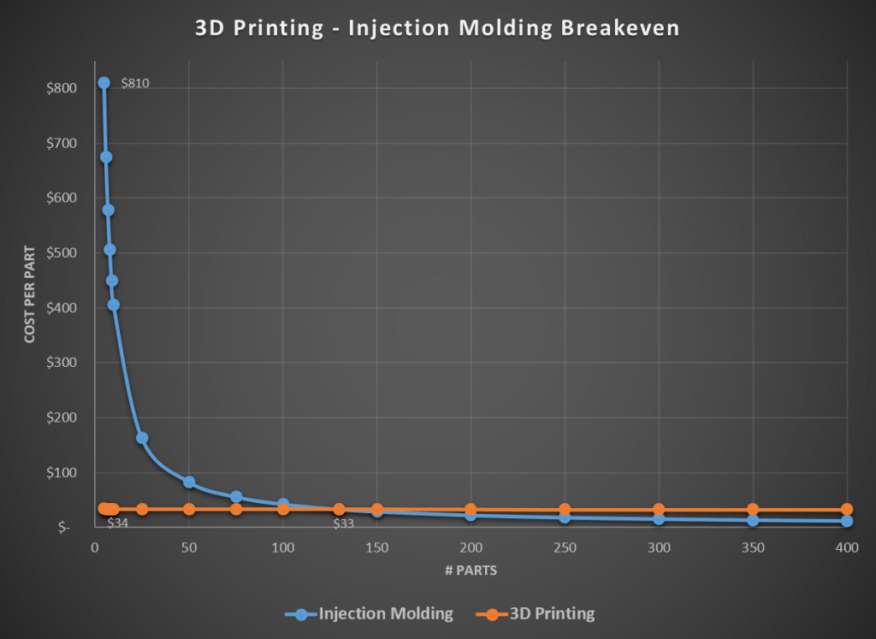
The above graph shows how cost per unit varies with total number of units produced between 3d printing and traditional methods.

Slide 19
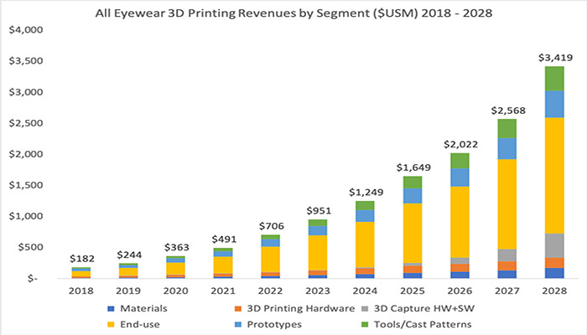
Growth of 3d printing industry
3D printing is still evolving and an increasing number of industries is adopting it. This means that the technology will develop to be more economical, iron out its limitations and offer better and newer materials, technologies, and a more sustainable manufacturing approach.
The table shows growth in the revenue and future possibilities of 3d printing industry from 2008 to 2028.

Slide 20
Can we make money with it?
We can earn money from providing some of the following services or product by our 3D Printing company.
Jewelry
Home decor items
Toys for kids
Glass frames made-on-order
Promotional Products Printing
Smart phone protective cases
Spare parts
Medical implants
Art work

Slide 21
Question answer session
If you have any question related to 3D Printer.
Please feel Free to Ask

Slide 22
THANKS

